Slide 1
Graph Neural Networks for Recommender Systems

Slide 2
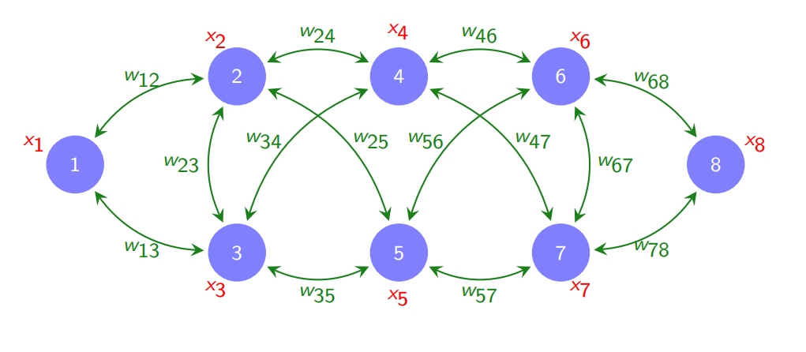
Graph Theory and why GNNs
Power of GNNs®
- Graph representations are found everywhere
- Extremely Low Latency
- Accommodate large data structures
- Handle multi-level tasks
.

Slide 3
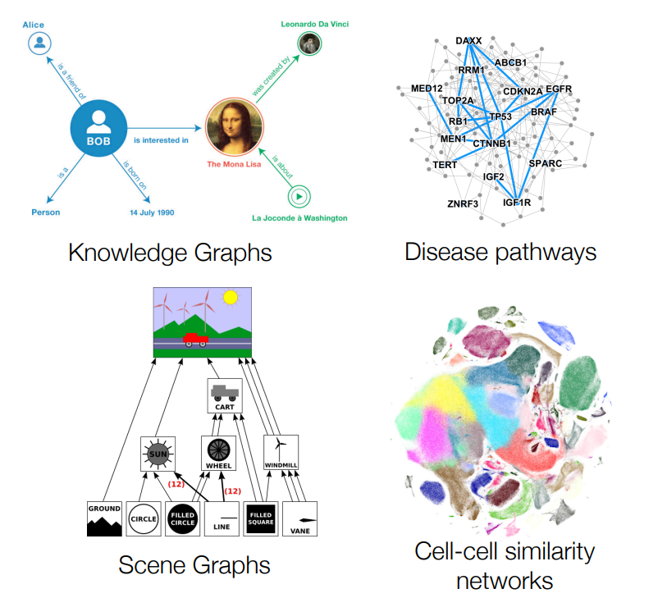
1. Traditional GNN Taks
- Node Level Tasks
- Edge Level Tasks
- Graph/Graphlet Level Tasks

Slide 4
This is a slide title
Here you have a list of items
And some text
But remember not to overload your slides with content
Your audience will listen to you or read the content, but won’t do both.

Slide 5
Big concept
Bring the attention of your audience over a key concept using icons or illustrations

Slide 6
GNNs for Recommender Systems
Strategies
- Node Similarity Embeddings
- Random Walk Strategies
- node2vec

Slide 7
My GNN Model
Dataset
List of ~ 50,000
Games obtained from Steam API
Variety of Features
- Release Year
- User reviews/rating
- Positive ratio
GraphConv
- Low Training ability
- Low shot learning
Evaluation
- Destroy random links in given nodes and pass through the model to predict their formation again.
Epoch: 001, Loss: 5233.4399, Val: 0.5714, Test: 0.6000
Epoch: 022, Loss: 222.3000, Val: 0.7143, Test: 0.8000
Final Test: 0.8000

